Slide 1
R for Data Science Chapter 3: Visualization
Marten van den Berg

Slide 2
3.1 Introduction
Install the tidyverse package
ggplot2 is based on a philosophy of making graphs: A layered Grammar of Graphics
5 major points in this grammar:
A default dataset and set of mappings from variables to aesthetics
One or more layers: each layer having one geometric object, one transformation, one position adjustment
One scale for each aesthetic mapping used
A coordinate system
A facet specification

Slide 3
3.2 First Steps
The mpg data frame
First plot
Ggplot(data = <DATA>) +
<GEOM_FUNCTION>(mapping = aes(<MAPPINGS>)

Slide 4
3.2 exercises
Run ggplot(data = mpg). What do you see?
ggplot(data = mpg)
How many rows are in mpg? How many columns?
234 rows, 11 columns
What does the drv variable describe? Read the help for ?mpg to find out.
f = front-wheel drive, r = rear wheel drive, 4 = 4wd
Make a scatterplot of hwy vs cyl.
ggplot(data = mpg) + geom_point(mapping = aes(x = hwy, y = cyl))
What happens if you make a scatterplot of class vs drv? Why is the plot not useful?
plot(data = mpg) + geom_point(mapping = aes(x = class, y = drv)) => dots on top of each other

Slide 5
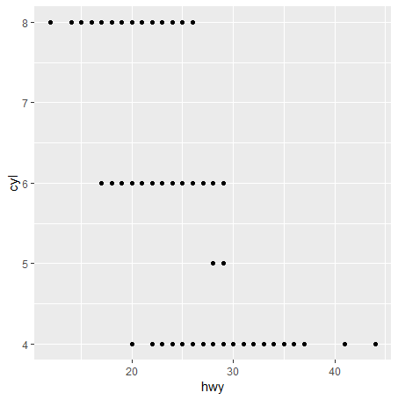
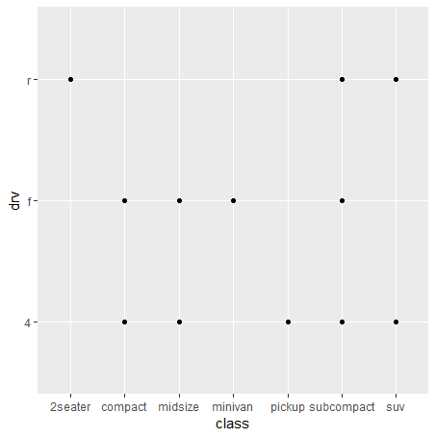
3.2 graphs

Slide 6
3.3 Aesthetic Mappings
Plot can show two variables based on X and Y position
More variables can be indicated with aesthetics (shape, size, color etc.) in aes()
ggplot(data = mpg) +
geom_point(mapping = aes(x = displ, y = hwy, color = class))
You can set an aestetic property but outside of aes()
ggplot(data = mpg) +
geom_point(mapping = aes(x = displ, y = hwy), color = "blue")

Slide 7
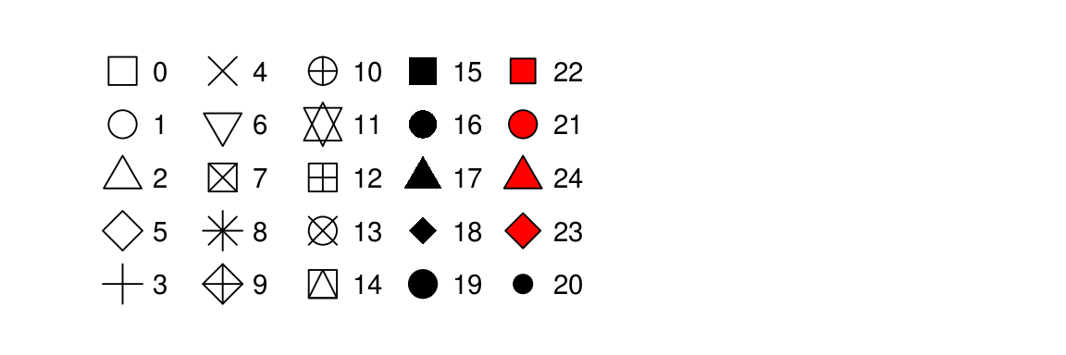
3.3 Aesthetic Mappings
Pick an aesthetic that makes sense in your case
Name of a color as character string
Size of a point in mm
Shape of a point

Slide 8
3.3 Exercises
What’s gone wrong with this code? Why are the points not blue?
ggplot(data = mpg) + geom_point(mapping = aes(x = displ, y = hwy, color = "blue"))
Which variables in mpg are categorical? Which variables are continuous? (Hint: type ?mpg to read the documentation for the dataset). How can you see this information when you run mpg?
Map a continuous variable to color, size, and shape. How do these aesthetics behave differently for categorical vs. continuous variables?
What happens if you map the same variable to multiple aesthetics?
What does the stroke aesthetic do? What shapes does it work with? (Hint: use ?geom_point)
What happens if you map an aesthetic to something other than a variable name, like aes(colour = displ < 5)? Note, you’ll also need to specify x and y.

Slide 9
3.3 Answers
Within aes() a vector or string is expected so the text “blue” is shown => move color outside of aes()
Type in mpg and a tibble is shown. <chr> variables are categories, <int> are usually continuous
Shape cannot be mapped to a continuous variable, otherwise a scale legend is shown. For categorical variables separate dots are shown and size is not recommended
The variable will have both aesthetics
Size of the border of elements 21-24
See graph, it shows the result of the statement

Slide 10
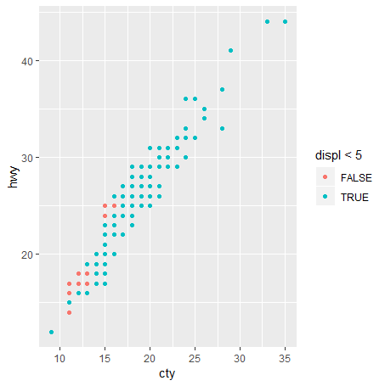
3.3 graphs

Slide 11
3.4 Common Problems
Check your spelling
?function_name
Google

Slide 12
3.5 Facets
Split your plot into facets
Single variable:
ggplot(data = mpg) +
geom_point(mapping = aes(x = displ, y = hwy)) +
facet_wrap(~ class, nrow = 2)
Two variables:
facet_grid(drv ~ cyl)
Single variable, but in a grid
facet_grid(. ~cyl)

Slide 13
3.5 Exercises
Facets on continuous variable gives lots of facets
Combinations between drv and cyl that do not exist => empty graphs
It creates a horizontal or vertical grid of one line; the dot makes sure the grid is of one variable.
Advantages grid: easily see differences between categories. Disadvantage grid: its not always clear how categories fit in the greater picture
Facet_wrap: nrows gives the number of rows and ncols gives the number of colums. In facet_grid rows and colums are fixed by the categories.
It is easier to compare horizontally than vertically.

Slide 14
3.6 Geometric Objects
A geom is the geometrical object that a plot uses to represent data.
geom_smooth gives a smooth line
ggplot2 provides over 30 geoms
To display multiple geoms in the same plot, add multiple geom functions to ggplot()
First set global mappings in gglot() then add the geom() functions.

Slide 15
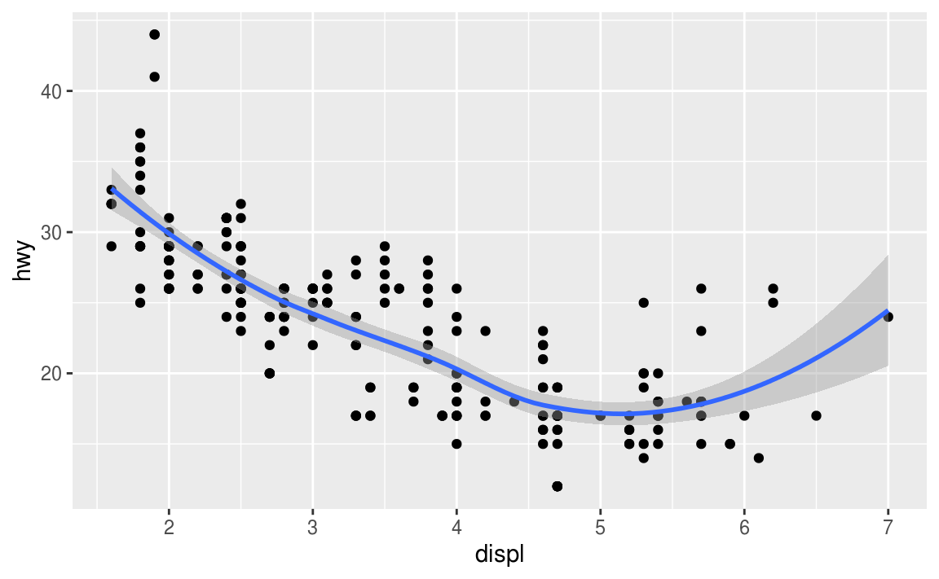
3.6. Geometric Objects
ggplot(data = mpg, mapping = aes(x = displ, y = hwy)) +
geom_point() +
geom_smooth()

Slide 16
3.6. Geometric Objects
Many geoms, like geom_smooth(), use a single geometric object to display multiple rows of data. For these geoms, you can set the group aesthetic to a categorical variable to draw multiple objects.

Slide 17
Them layers
If you place mappings in a geom function, ggplot2 will treat them as local mappings for the layer. It will use these mappings to extend or overwrite the global mappings for that layer only. This makes it possible to display different aesthetics in different layers.
ggplot(data = mpg, mapping = aes(x = displ, y = hwy)) +
geom_point(mapping = aes(color = class)) +
geom_smooth()

Slide 18
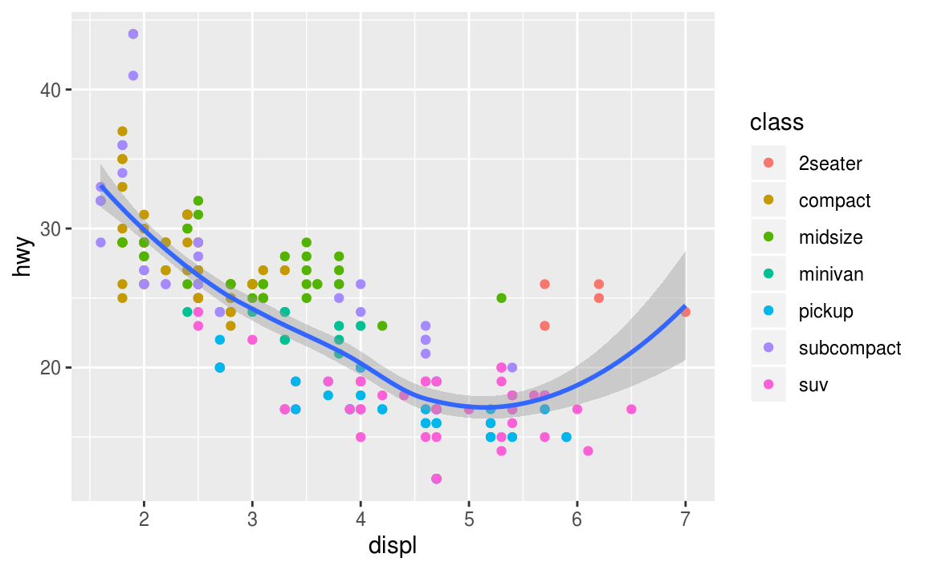
ggplot(data = mpg, mapping = aes(x = displ, y = hwy)) + geom_point(mapping = aes(color = class)) + geom_smooth()

Slide 19
More layers
You can use the same idea to specify different data to different layers
ggplot(data = mpg, mapping = aes(x = displ, y = hwy)) +
geom_point(mapping = aes(color = class)) + geom_smooth(data = filter(mpg, class == "subcompact"), se = FALSE)

Slide 20
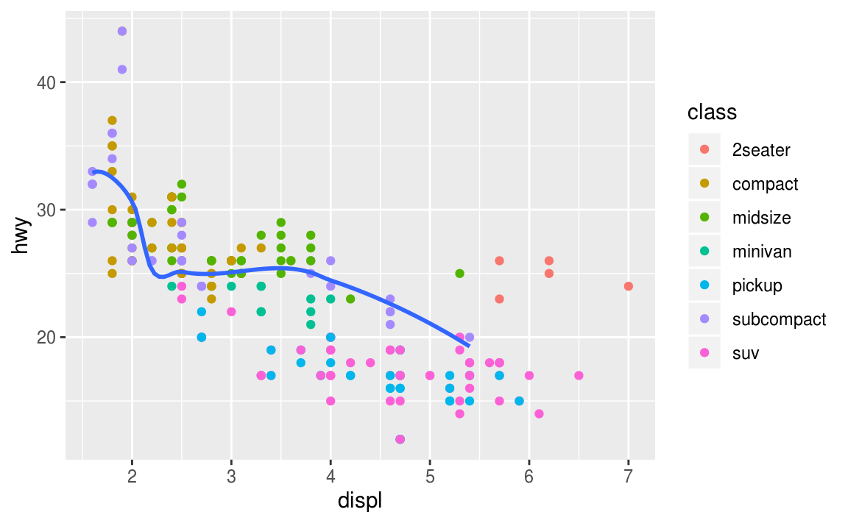

Slide 21
3.6 Excersises
Geom for:
Line chart => geom_line
Boxplot => geom_boxplot
Histogram => geom_histogram
Area Chart => geom_area
Show.legend = FALSE supresses the Legend
SE: plot standard error

Slide 22
3.7 Statistical transformations

Slide 23
3.8 Position Adjustments

Slide 24
3.9 Coordinate Systems

